Slide 1
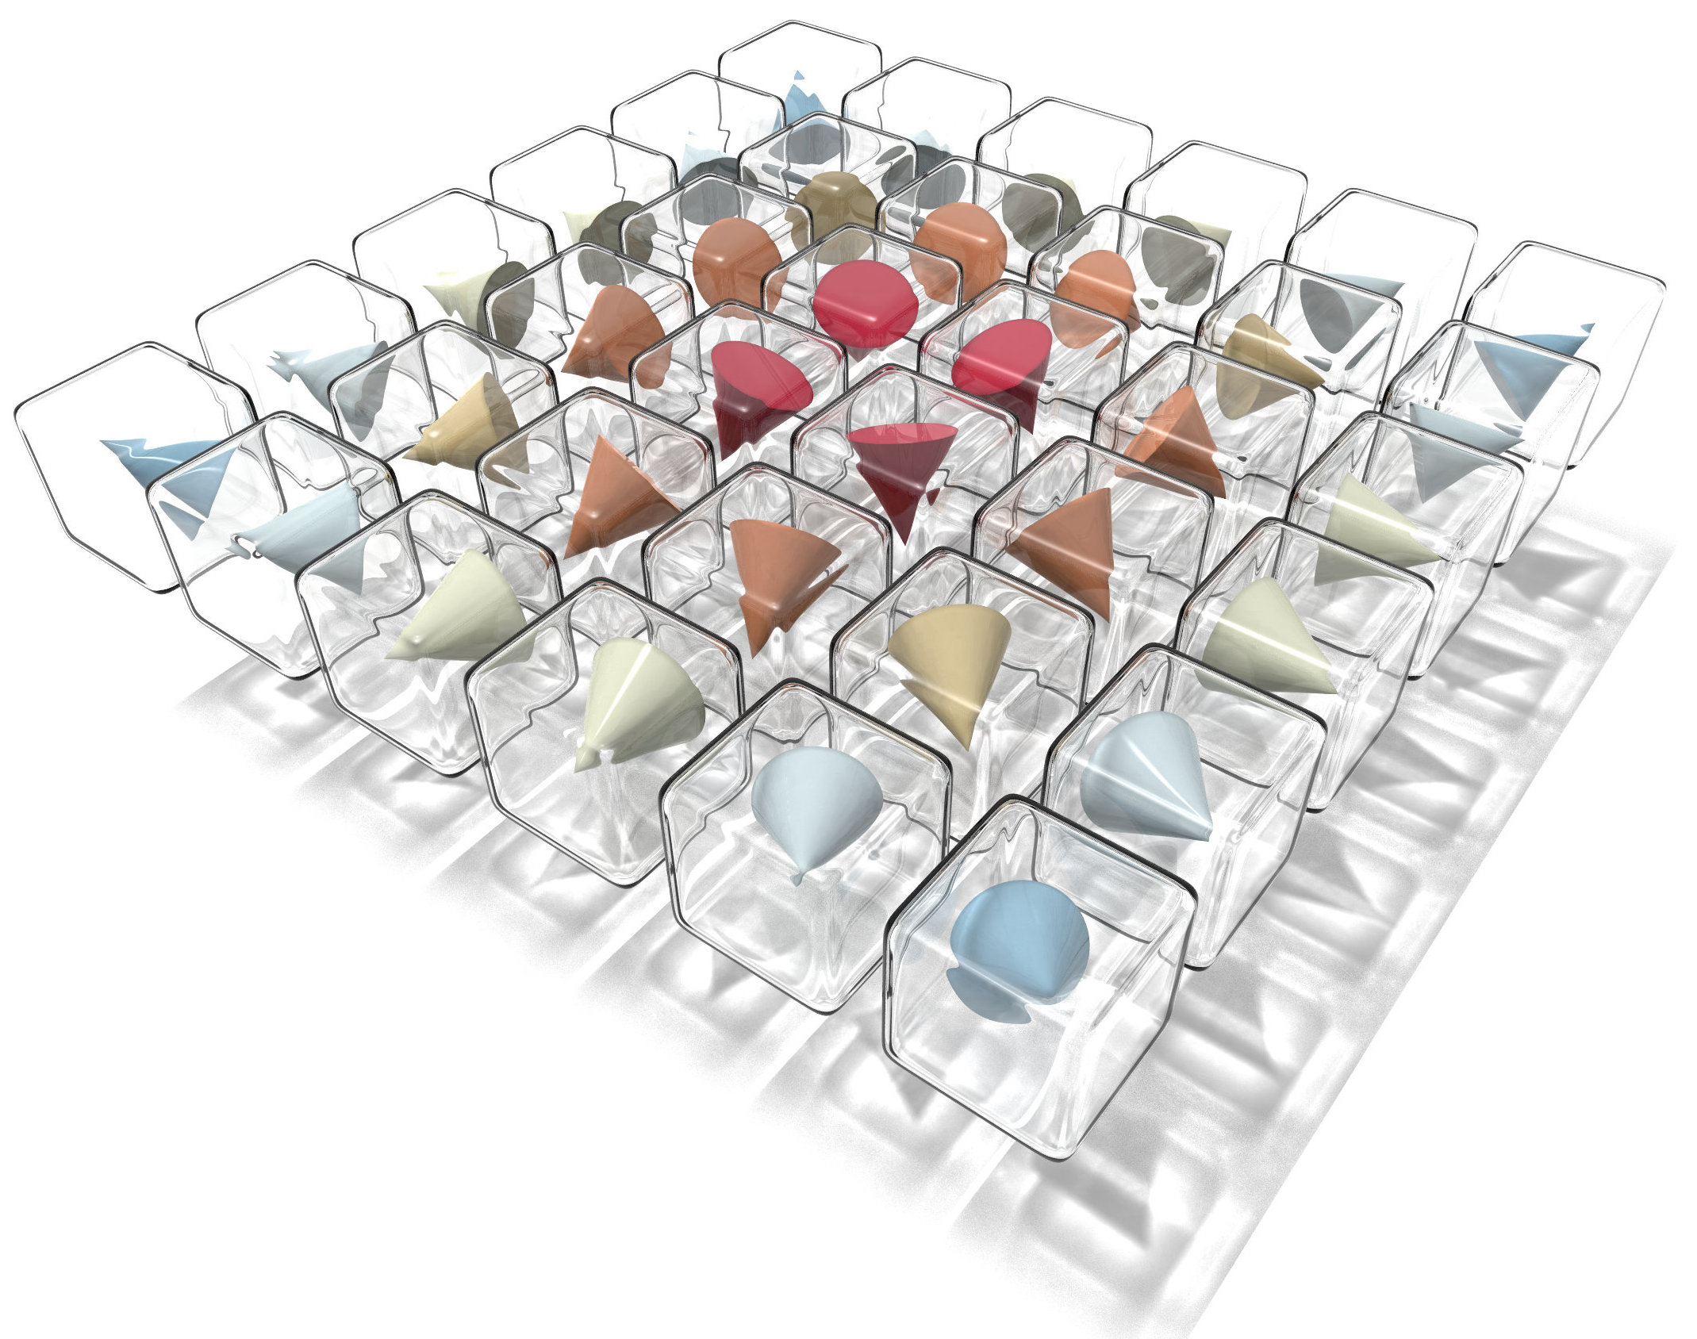
Search for a Bloch point using the Mean-field model
Zonghui Liu MSc in Applied Computational Science and Engineering
Supervisors:
Dr Marijan Beg
Dr Swapneel Amit Pathak
Notes:
Hi, my name is Zonghui Liu. And today I will introduce my IRP which is xxx.

Slide 2
PART 0 - MOTIVATION
WHY BLOCH POINT?
nanoscale singularity[1]
high data density
H-H & T-T Bloch points stably exist[2]
Bloch point
two stable states
competitive memory
can switch between each other
Hysteresis[2]
[1] W Do ̈ring. Point singularities in micromagnetism. Journal of Applied Physics, 39(2):1006–1007, 1968.
[2] Beg, Marijan, et al. "Stable and manipulable Bloch point." Scientific reports 9.1 (2019): 1-8.
Notes:
From the previous work, we know that the BP has the three properties and they lead to the three behaviours respectively, which are key features of a competitive memory.

Slide 3
PART 0 - MOTIVATION
WHY SIMULATIONS?
More efficient
Easy to use
Get results quickly
...
Notes:
But why we use simulations to study BP? Because it's efficient, easy to use and able to get results spontaneously.

Slide 4

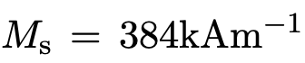
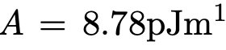
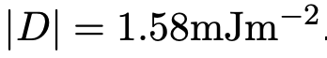
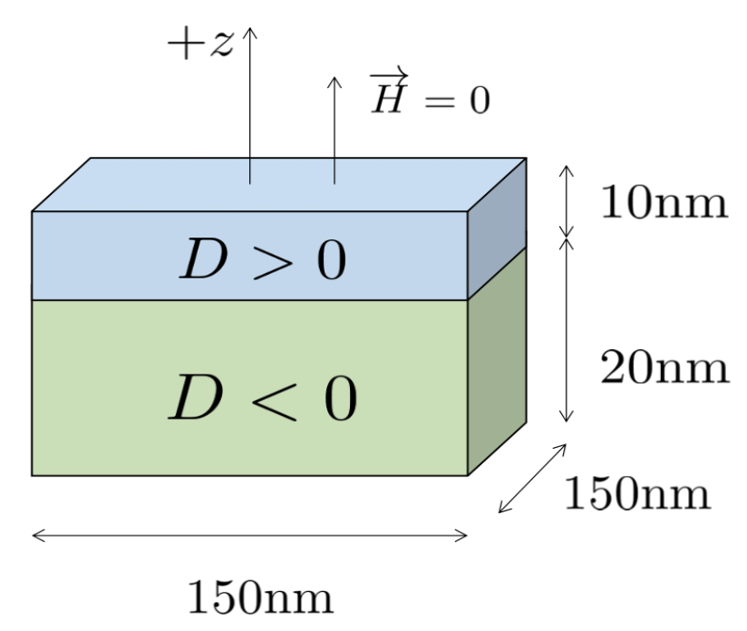
PART 1 - OBJECT OF STUDY
Material: Cubic B20 FeGe
Parameters:
[1]
[1]
Initialize the system
the Mean-field model
used to
Reach the equilibrium state
Study the stability of Bloch points
Fig1 The geometry of the studied system
Study the hysteretic behaviour of Bloch points
[1] Beg, Marijan, et al. "Stable and manipulable Bloch point." Scientific reports 9.1 (2019): 1-8.
Notes:
Fig1 shows 标题. The whole system is composed by two parts, they are both made by FeGe, but with opposite chiralities. The two different chiralties are shown by capital D and they are the key point of generating BPs. In the system, in order to prove the stability and the hysteresis of BPs, we need to reach the equilibrium state first. This process is implemented by the MF model.

Slide 5
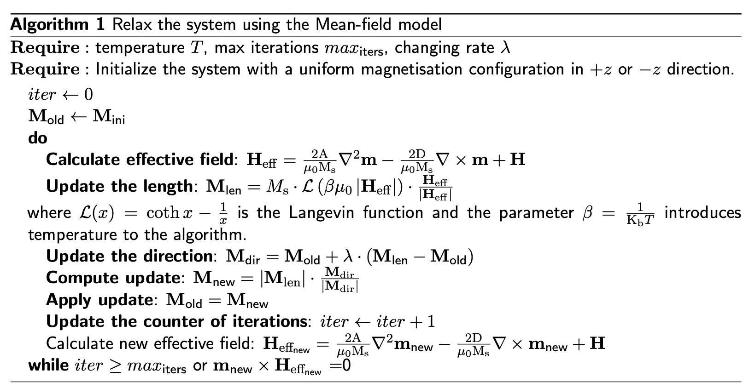
PART 2 - MEAN-FIELD MODEL
Part A
Part B
Part C
Notes:
After initialization, we enter into the iteration. There are three main parts in MF model. The effective field that calculated in part A is used to update the magnetization in part B. And finally we use the results from both A and B to determine whether the iteration should stop, which is part C.

Slide 6
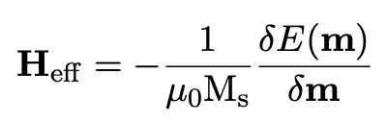
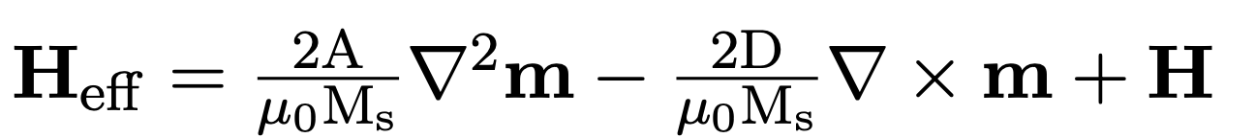
PART 2 - MEAN-FIELD MODEL
A. EFFECTIVE FIELD
Effective field points in the opposite direction of the system energy gradient.
Definition of effective field
Calculation of effective field
Exchange
DMI
Zeeman
Notes:
In order to update the magnetization along the defined direction, the effective field is calculated before updating magnetization. From the definition equation of effective field, we know that 右1. So the effective field will take the system to the state with the lowest energy, which is also called the equilibrium state. There are 3 components of the effective field in the system which are Exchange, DMI and Zeeman.

Slide 7
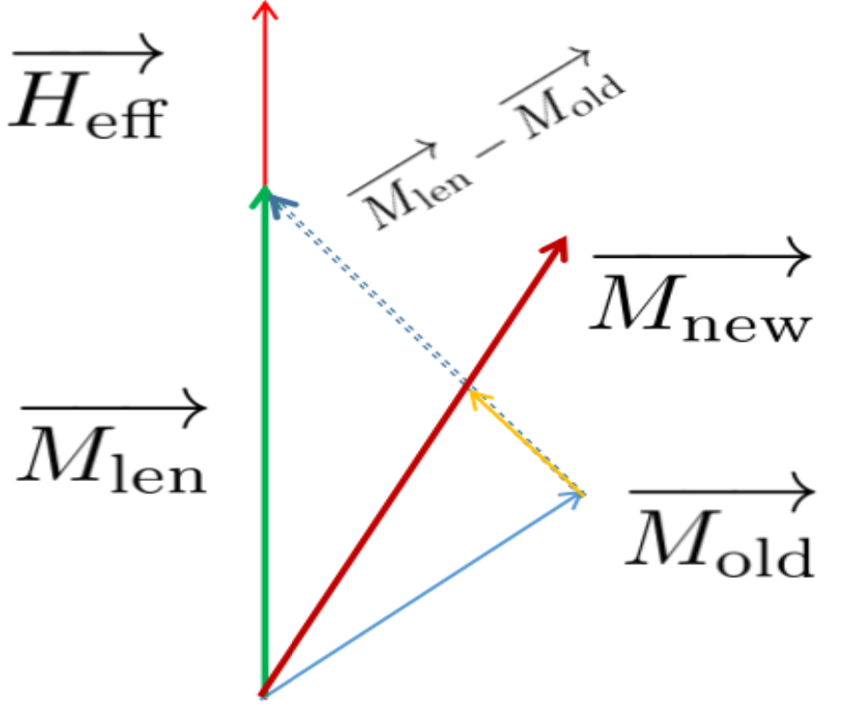
PART 2 - MEAN-FIELD MODEL
B. Update Magnetization
1
1
4
2
3
3
2
0
4
Fig2: The Geometric schematic of updating magnetization
Notes:
Fig2 shows the process of updating the magnetization at each iteration. M_old indicates the magnetization of the last iteration, the H_eff indicates the ideal destination direction for this iteration. The M_len is the result of updating length. It's along the direction of the effective field and its length is updated by the result of 朗之万 function. The influence of temperature can be introduced through beta. Next, the yellow arrow indicates the decayed vary from M_old to M_len. The decay factor lambda is used to make the magnetization update gradually, smoothly and dynamically, which makes the numerical solution more close to the real one. Finally we get the updated magnetization M_new. M_new uses the length of M_len and it's along the direction of M_dir, which is the vector sum of M_old and the yellow vector. Over the iterations, we want the M_new to gradually move in the same direction as the H_eff. That means the system don't need to change any more and the equilibrium state is found.

Slide 8
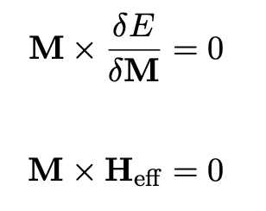
PART 2 - MEAN-FIELD MODEL
C. EQUILIBRIUM STATE
Energy minimization can be reprsent by the Brown's condition:
The ideal stopping criteria of the simulation:
Notes:
The Brown's condition can be used to define which state is the equilibrium state. Since we have calculated the effective field in Part A, the Brown's condition can be explained using the cross product of magnetization and effective field. However, this rule is only a part of the stopping criteria in simulations.

Slide 9
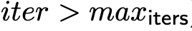
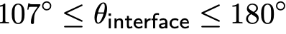
PART 2 - MEAN-FIELD MODEL
C. STOP CRITERIA
1. Stop when arriving at the maximum iterations
represents the maximum computational cost we can accept
2. Stop when the magnetization and its effective field are in the same direction
If the algorithm convergent before the max iteration, we can save computing resources.
3. Stop according to the physical meaning of the Bloch point
The Mean-field model cannot convergent when there is a singularity in the system, because the magnetization is discontinuous and not differentiable
when the angle of the magnetization at the interface is greater than 107 degrees.
Notes:
In simulations for BPs, the MF model uses three conditions to determine whether to stop the iteration. Any one of them is satisfied, the iterations will stop. 第一行. The second condition makes the algorithm convergent before the max iterations when the magnetization and its effective field are in the same direction. The third conditions第三行 comes from the experience of simulations. When searching for a BP, it is found that 不可导. The results of Laplacian and curl are not correct and the incorrectness leads to the wrong result of effective field. So the second condition is useless. But we can use the angle constraint to make the algorithm convergent before the max iterations.

Slide 10
PART 2 - MEAN-FIELD MODEL
ADVANTAGE
High efficiency
along the defined direction(effective field)
update all lattice at once
Introduce the influence of temperature
Show the detailed structures of Bloch points
Notes:
The advantage of the MF model is high efficiency, since the magnetization is updated for all of the lattice at once and each update is along a defined direction, the direction of effective field. For example, the MF model only need about 8000 iterations to reach the equilibrium state for the system consisting of around 43,000 cubic lattice. The model introduce the effect of temperature through beta. And the detailed structures of BPs could be observed.

Slide 11
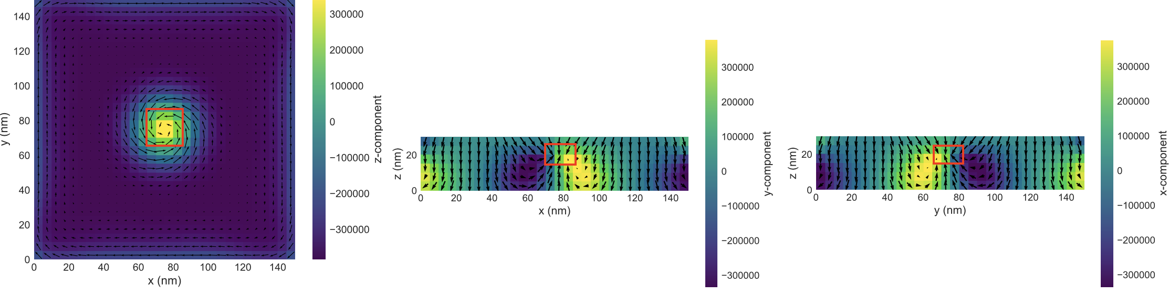
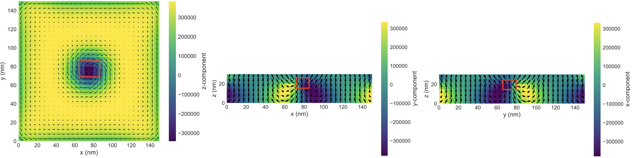
PART 3 - RESULTS
RESULT:
STABILITY
Two types of Bloch points appear at the interface, when the system is relaxed to the equilibrium state using the Mean-field model
Fig3: The structures of two types of Bloch points
Notes:
In the objective system, there are 2 types of stable BPs appear at the center of the interface, when the temperature equals to 0 and the external magnetic field equals to -0.1T and 0.1T respectively. The structures of BPs can be observed after finding the equilibrium state using the Mean-field model. For memory, the two BPs can be used to represent 0 and 1 respectively.

Slide 12



PART 3 - RESULTS
RESULT:
STABILITY
The magnetization at the centre of the interface offset each other, resulting in a stable Head-to-Head Bloch point.
Fig4: The detailed structure of Head-to-Head Bloch points
Notes:
The fig4 shows the detailed structure of the H-H BP. The three subfigures are the magnetization when observing the system along the z, y and x direction respectively. When we zoom in, we can see that the magnetization offset each other and the stable H-H BP appears at the center of the interface. The length of the magnetization tends to be 0 at the center of the BP, which is satisfied the def of the BP. Compared to previous work, the length of magnetization in MF model is no longer a constant, but change with itration. The update both in length and in direction allows us to observe the correct and detailed structures of BPs.

Slide 13
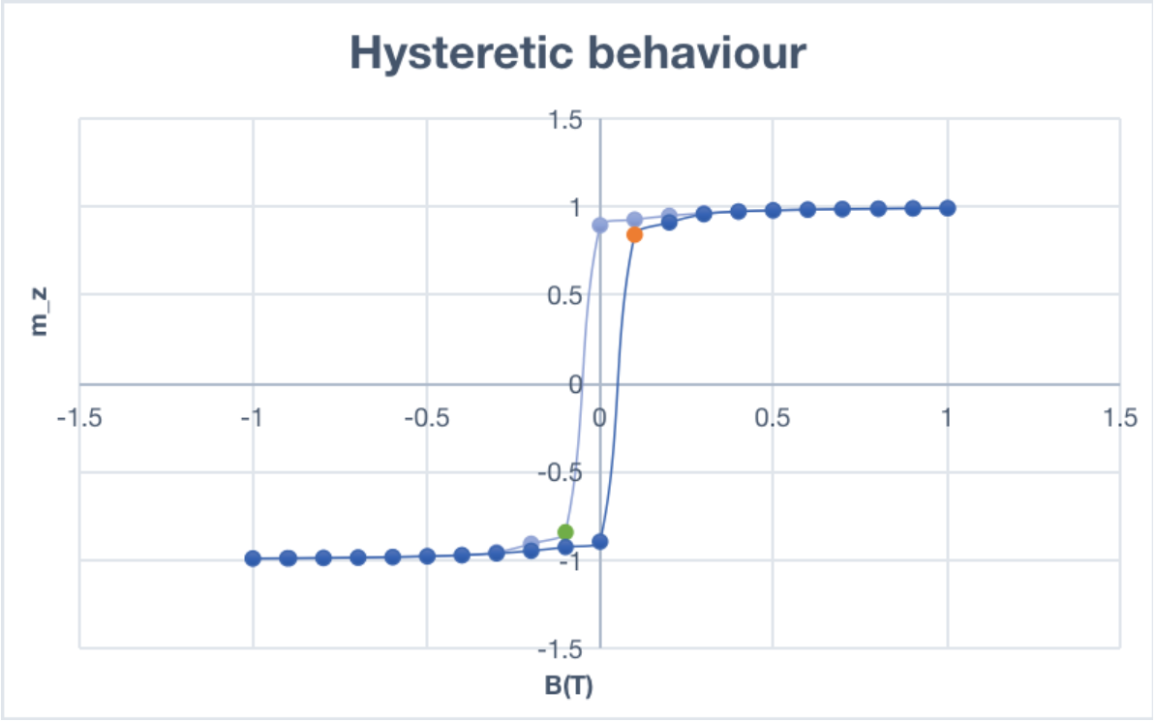
PART 3 - RESULTS
RESULT: HYSTERESIS
Head-to-Head
Bloch Point
H-H to T-T:
increase to 1T
decrease to -0.1T
T-T to H-H:
decrease to -1T
increase to 0.1T
-0.1
0.1
Tail-to-Tail
Bloch point
Fig5: The hysteretic behaviour of the system
Notes:
The Fig5 shows the dependency of the average out-of-plane magnetisation component mz on the external magnetic field B. The orange dot indicates the H-H BP and the green one indicates the T-T BP. The two types of BPs can switched between when changing the external magnetic field. For example, when we have a T-T BP , first, we decrease the field to -1T, then increase it to 0.1T and finally we got the H-H BP. Vise versa.
For memory, this hysteresis loop means that 0 and 1 can be switched between each other when changing the external magnetic field.

Slide 14
PART 4 - CONCLUSION
This project implements the Mean-field model
Using the Mean-field model, the stability and hysteretic behaviour of Bloch points are studied.
Stability: the detailed structures of two Bloch points
Hysteresis: the two can be switched between when changing the external magnetic field
In summary, this project demonstrates that Bloch point is a very promising topological quasiparticle for data storage.
Notes:
1min

Slide 15
Q&A
Notes:
OK, next is Q&A time.

Slide 16
Thanks for listening!
Notes:
That's all, thanks for listening!

